Slide 1


Beyond the Clouds, The Discovery Initiative
Energy/cost-benefit analysis of a decentralized Cloud infrastructure
Anne-Cécile Orgerie, Adrien Lèbre
July, 2015 – Discovery meeting
Notes:
L’idée de depart: est ce que le cloud computing est LE modele d’UC abouti.
3 parties : Pourquoi il est necessaire de proposer une architecture d’UC nouvelle
Zoom sur la gestion dynamique des VMs dans ce nouveau cloud

Slide 2
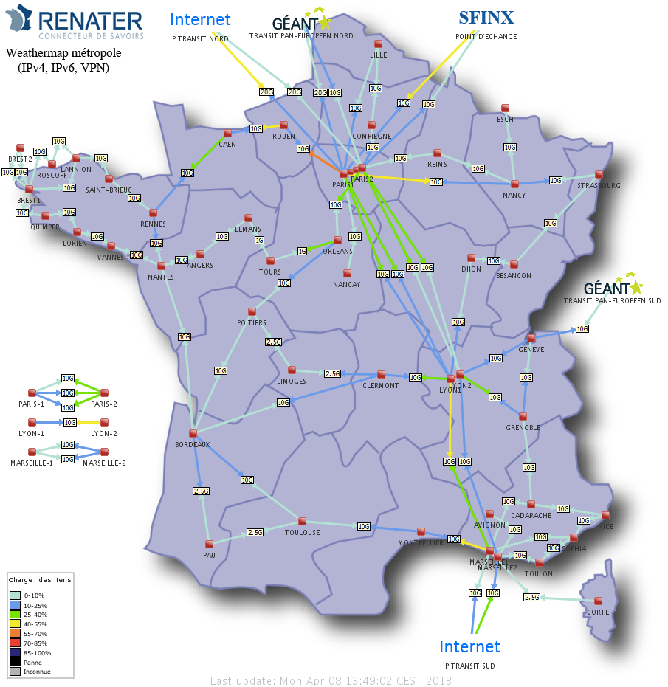
Case study: Renater
Considered aspects:
Order of magnitude for financial aspects
Organizational constraints
Technical constraints
Exploitation constraints
Energy aspects
Notes:
Listing pour les contraintes, focus plus particulier sur energy et aspects financiers

Slide 3
Practical methodology
Look at Renater’s backbone
Locate where additional servers could be hosted
Estimate the additional costs (energy, financial, constraints)
Estimate the benefits (number of hosted VMs, etc.)
Compare against a centralized architecture

Slide 4
PoP level: hosting additional servers
Cooling costs for these new servers
possibility of free cooling
load balancing over several sites to exploit renewable energy
Energy costs
servers’ + switches’ energy conso ≤ available energy at PoP
higher kWh prices than in a DC (no wholesale price)
More network traffic?
➔ Services closer to the users: global compensation? associated costs? More links to deploy?
Managing costs ?

Slide 5
Deploying a LUC on top of RENATER
Infrastructure | IT’s Energy | Network Energy | Total | Nb | Overall
Large PoP | 7,6 | 1,3 | 8,9 | 6 | 53,4
Medium PoP | 2,7 | 0,35 | 3,05 | 30 | 91,5
Small PoP | 2,2 | 0,35 | 2,55 | 36 | 91,8
 |  |  |  | Overall | 236,7
Shelter |  | 0,2 |  | 198 | 39,6
 |  |  | Overall with shelters |  | 276,3
Energy consumption of RENATER (estimates in kW)
Infrastructure | Total Energy (IT + Network) |  | Nb | Overall | Nb VMs
1 unit of 100 VMs (10 nodes) | 4 |  | 50 | 200 | 5000
Energy consumption of one 500 nodes cloud (estimates in kW)

Slide 6
Deploying a LUC on top of RENATER
Infrastructure | Nb | Total | Available Energy/PoP | Overall | Overall (after extension) | Nb VMs | Nb units
Large PoP | 6 | 8,9 | 16 | 53,4 | 149,4 | 2400 | 4 x 6
Medium PoP | 30 | 3,05 | 4 | 91,5 | 211,5 | 3000 | 1 x 30
Small PoP | 36 | 2,55 | 0 | 91,8 | 91,8
 |  |  | Overall | 236,7 | 452,7 | 5400 | 54
Shelter | 198 | 0,2 |  | 39,6 | 39,6
 |  | Overall with shelters |  | 276,3 | 492,3
1 unit = 10 servers, 100 VMs, 4 kW

Slide 7
Where We Are
Validation of the LUC model (on-going work with RENATER, the French NREN)
From energy/efficiency/economical point of views
On a brick basis (100 VMs) and by considering the cost of the network.
An academic POC for validating the feasibility of major blocks (scheduling of VMs, migration between distinct sites…)
Two PhDs, Two PostDocs
Managing 10K VMs on top of Grid’5000 like normal processes on a laptop.
Hiring a new post-doc in September
Notes:
- No real sucess stories (for instance SSI technologies)
- each node runs a discovery agent

Slide 8
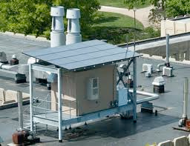
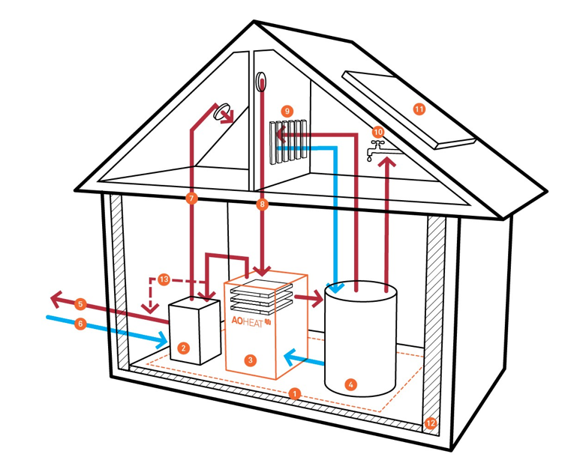
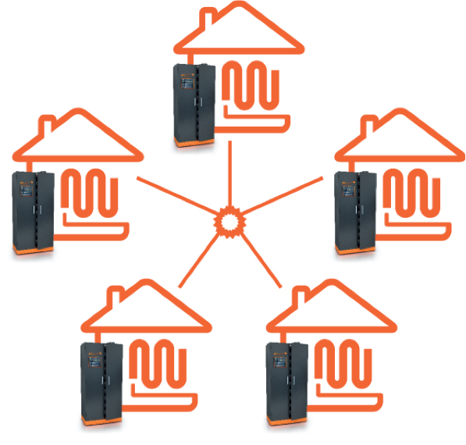
Beyond Discovery !
From sustainable data centers to a new source of energy A promising way to deliver highly efficient and sustainable UC services is to provide UC platforms as close as possible to the end-users and to...
Leverage ‘’green’’ energy (solar, wind turbines...) Transfer the green micro/nano DCs concept to the network PoP Take the advantage of the geographical distribution
Leveraging the data furnaces concept
Deploy UC servers in medium and large institutions and use them as sources of heat inside public buildings such as hospitals or universities
http://parasol.cs.rutgers.edu
https://www.aoterra.de
Notes:
UC platforms should be tightly coupled with any facilities available through the Internet, starting from the cores routers of the backbone, the different network access points and any small and medium-size computing infrastructures that may be provisioned by Internet Service Providers (ISPs), governments and academic institutions.The definition of a complete distributed system in charge of turning a complex and diverse network of resources into a collection ofabstracted computing fa- cilities that is both easy to operate and reliable
Attention exemple de pizza: aucun interet d’un point de vue du restaurant mais interet d’un point de vue impact performance (latence)+energy footprint

Slide 9
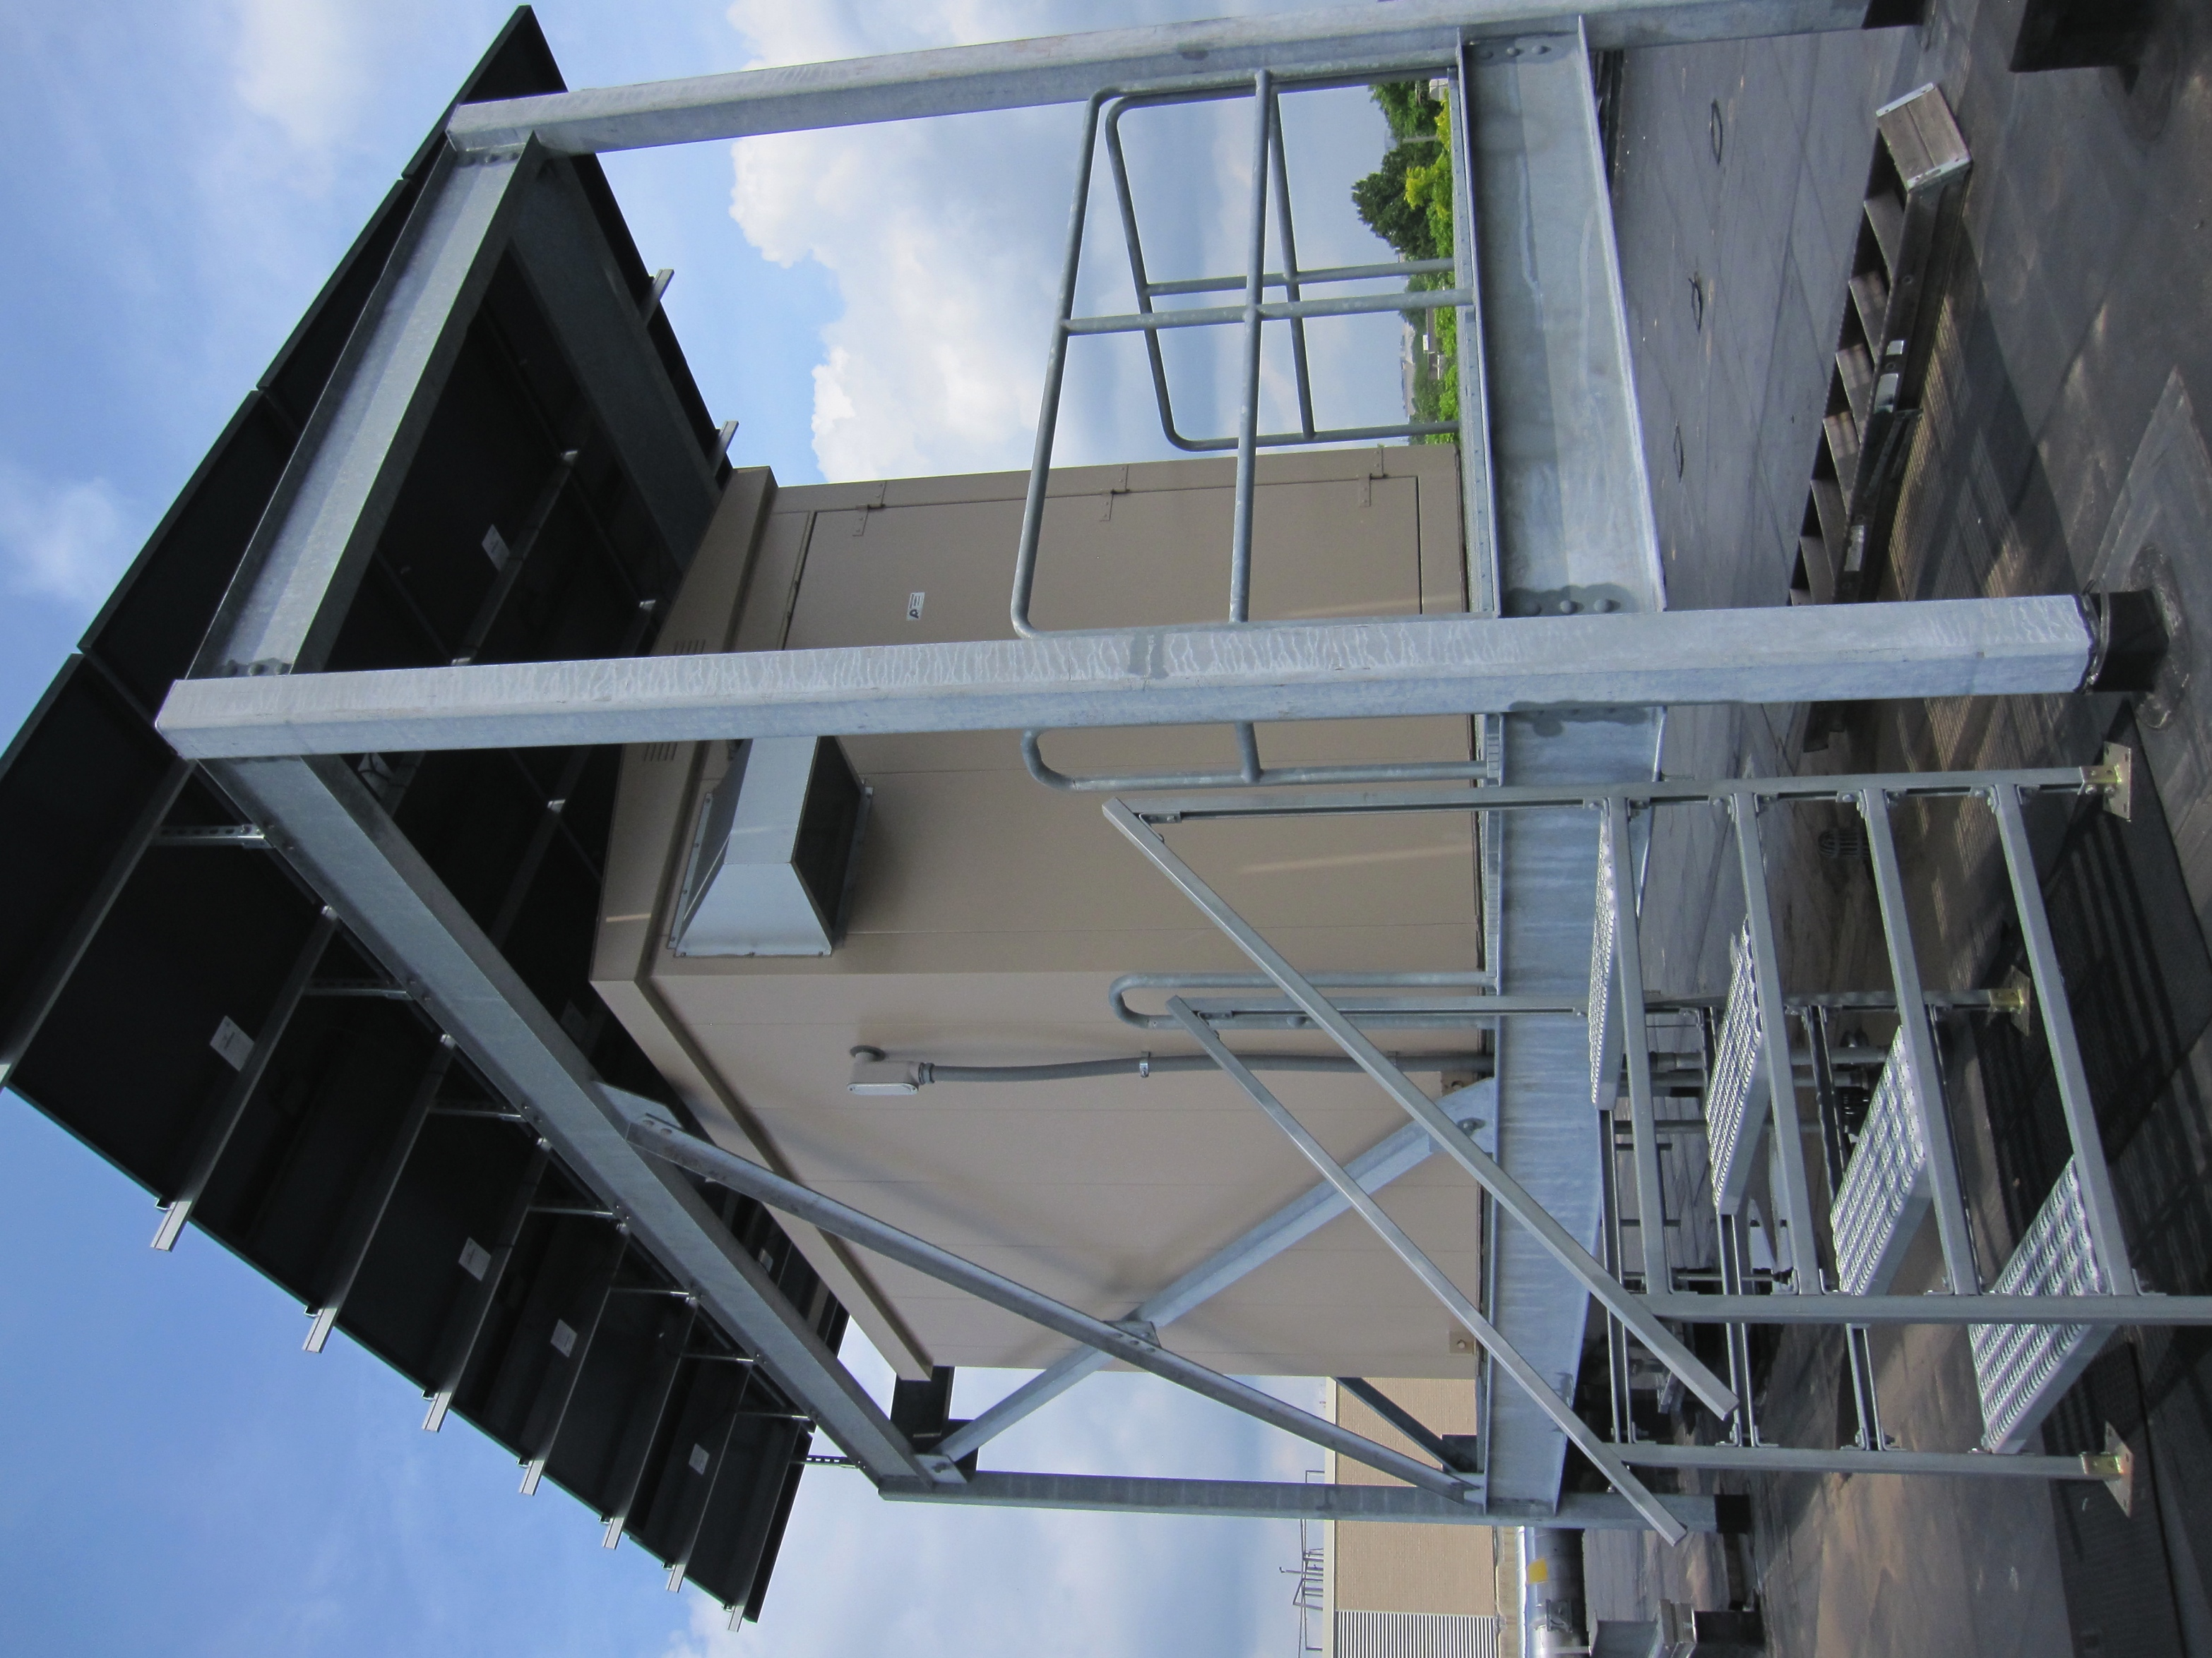
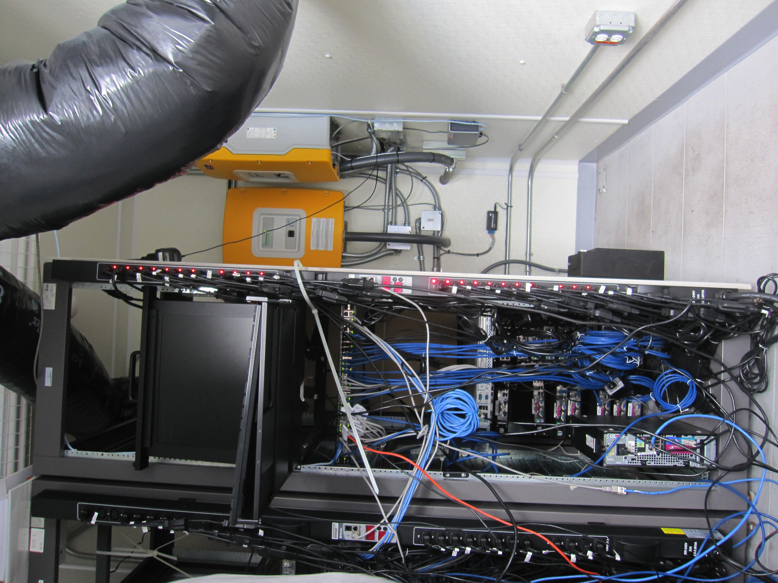
Exploiting renewable energy
http://parasol.cs.rutgers.edu

